Slide 1
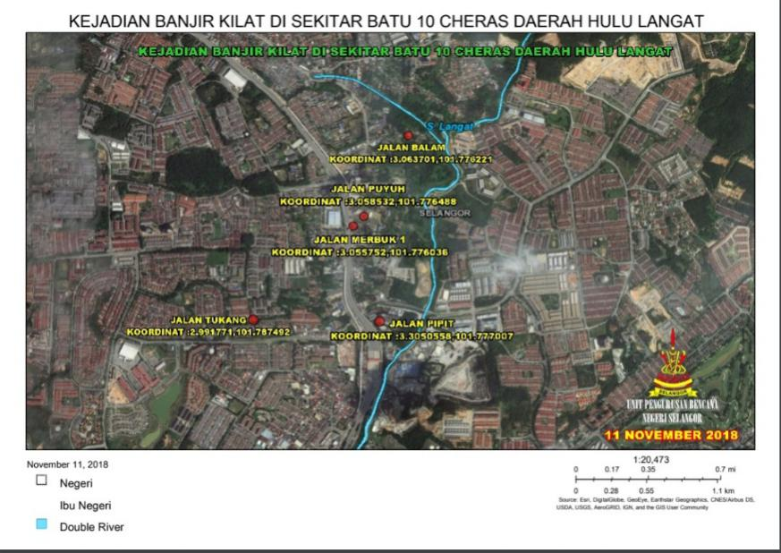
REKABENTUK TERPERINCI BAGI PROJEK TEBATAN BANJIR DI KAMPUNG BATU 10, MUKIM CHERAS, DAERAH HULU LANGAT, SELANGOR DARUL EHSAN
JABATAN PENGAIRAN DAN SALIRAN SELANGOR

Slide 2
INTRODUCTION
The State Government of Selangor (the Government) through its implementing agency, Jabatan Pengairan dan Saliran Selangor (JPS), requires engineering consultancy services to prepare a study and detailed design for preparation of tender for “REKABENTUK TERPERINCI BAGI PROJEK TEBATAN BANJIR DI KAMPUNG BATU 10, MUKIM CHERAS, DAERAH HULU LANGAT, SELANGOR DARUL EHSAN’’
The detailed design of the flood mitigation works up to and including the preparation of the final tender documents shall be completed within TEN (10) months from the date of commencement of Services.

Slide 3
BACKGROUND
The Langat River Basin is located in three districts, namely Hulu Langat, Sepang and Kuala Langat Districts. The length of this river is 149.3 km from upstream to the river mouth. The main focus of this project is in the upstream area where the river has a high and rapid flow rate.
.

Slide 4
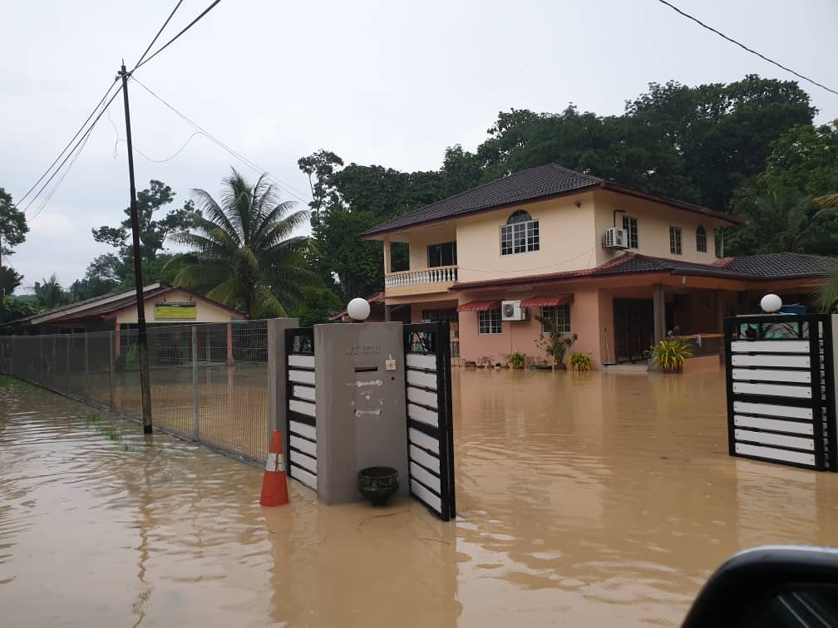
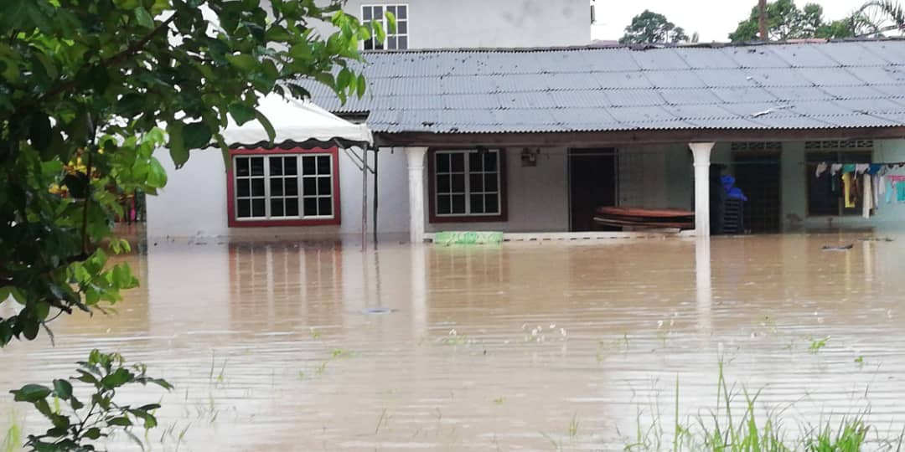
BACKGROUND
There are other rivers that enter Sungai Langat such as Sungai Lui, Sungai Gahal in upstream and Sungai Sering, Sungai Raya, and Sungai Cheras in downstream. In Kampung Batu 10 itself, there are also several main drain that enter Sungai Langat, which are drain at Jalan Puyuh and Jalan Pipit.
The rapid development in the upstream caused floods in several areas in Sungai Langat, Hulu Langat District such as Jalan Persekutuan Dusun Nanding, Kg. Sungai Gahal, Kg. Sungai Serai, Kg. Batu 10 and so on. The development and construction of highways (Elevated Klang Valley Expressway – EKVE) and Logi Rawatan Air Langat Phase 2 in the upstream has also increased the flow of surface water and caused the risk of flooding with the frequency of floods in Kg Batu 10 approximately 5 times in a year.

Slide 5
OBJECTIVE
The objective of this consultancy service is to prepare detailed design and tender table documents for the purpose of implementing storm water management and flood mitigation project in flood prone areas along Sungai Langat at Kampung Batu 10, Daerah Hulu Langat.

Slide 6
PROJECT OBJECTIVE
a) Based on the rapid development, exploration of the area and increasing population density, the drainage system in the area/ Basin of Sungai Langat at Kampung Batu 10 needs to be upgraded to further reduce the problem of frequent floods. The implementation of flood mitigation will reduce the risk of loss of residents, traders, entrepreneurs, farmers, ranchers and public property.
b) Study of pond needs at Jalan Puyuh Kg Batu 10.
c) Study of river improvement works, slope stabilization/protection requirements and upgrading of bund
d) Upgrading/ build outlets structure/ crossing along Sungai Langat
e) Study of spillway/ flapgate needs/ requirements
f) Study of pump system/ pump house/ gate requirements

Slide 7
SEKIAN, TERIMA KASIH
BAHAGIAN PENGURUSAN BANJIR
JPS SELANGOR

